Slide 1

PlugNdraw

Slide 2
One doesn’t simply choose a favorite drawing app
Most apps have limited functionality that often doesn’t meet users needs
Users miss functionality from other apps
I wanted to add my own features to the apps

Slide 3

Developers can easily add cool functionality to PlugNdraw by adding a plugin and they don’t have to worry about writing an entire app

Slide 4
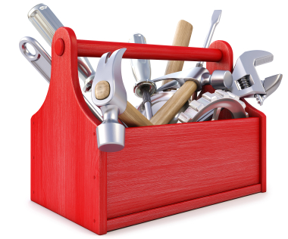
Users can choose a plethora of tools from different developers that fit their needs

Slide 5

PlugNdraw is a platform
Our goal is to help plugin developers help users

Slide 6
Undoing mistakes
Notes:
I evaluated many options for undoing mistakes

Slide 7
Control z has limitations
it only undos blocks of changes. Craig, a chemical engineer, complained that his Autodesk program doesn’t let him undo parts of a line.
Once you undo and make a change you can’t redo
Undo usually doesn’t work once you reopen the app
You can’t control the rate at which you undo

Slide 8
Revision control has issues
hard to use
One can only undo very large blocks of changes

Slide 9
Since the current systems have issues I created my own innovative solution

Slide 10
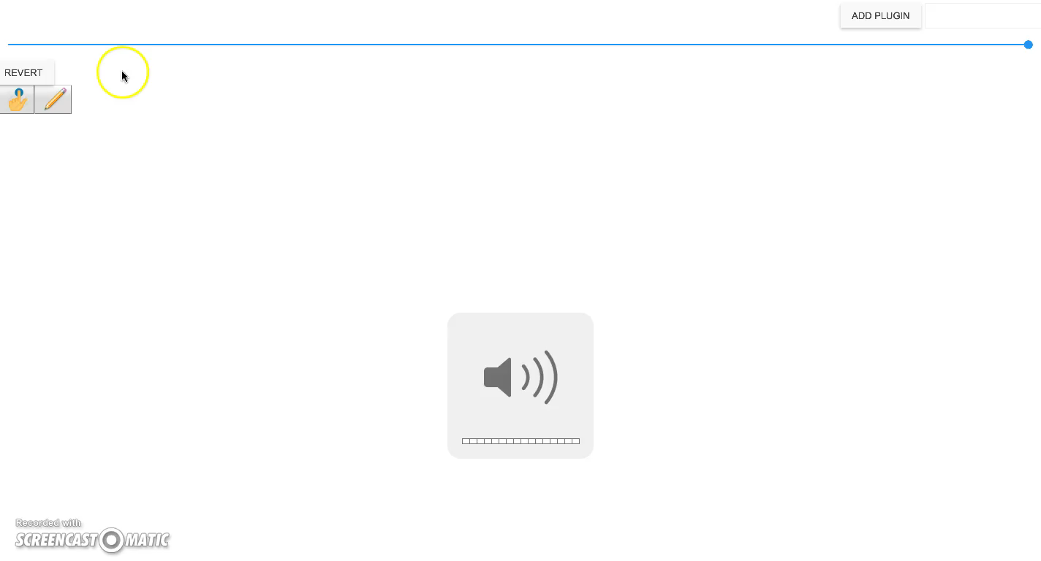

Slide 11
My system
Plugins can easily participate
It’s intuitive because it’s like a youtube slider
Undo or redo any change
At over 60 frames per second it’s incredibly fast
Replay drawing

Slide 12
I want to help developers and some developers are already interested. My internship plans to use this to play back what the user did and they can easily leverage the code

Slide 13

While collaboration is extremely cumbersome in most apps, PlugNdraw features real time collaboration so several users can can collaborate on the same drawing simultaneously.

Slide 14
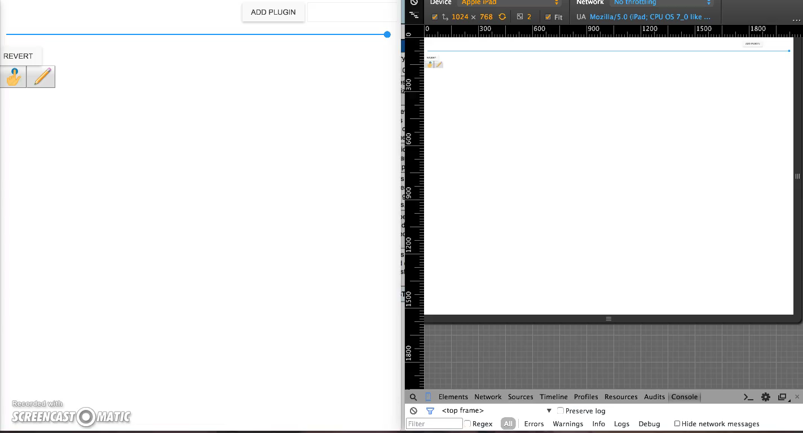

Slide 15
Were heavily involved in the open source community.
We really love the community. This wouldn’t have been possible without them and we always try to give back as much as we can.
contribute to open source projects
create issues
ask and answer questions on stack overflow
propose things to open source projects
use open source projects

Slide 16
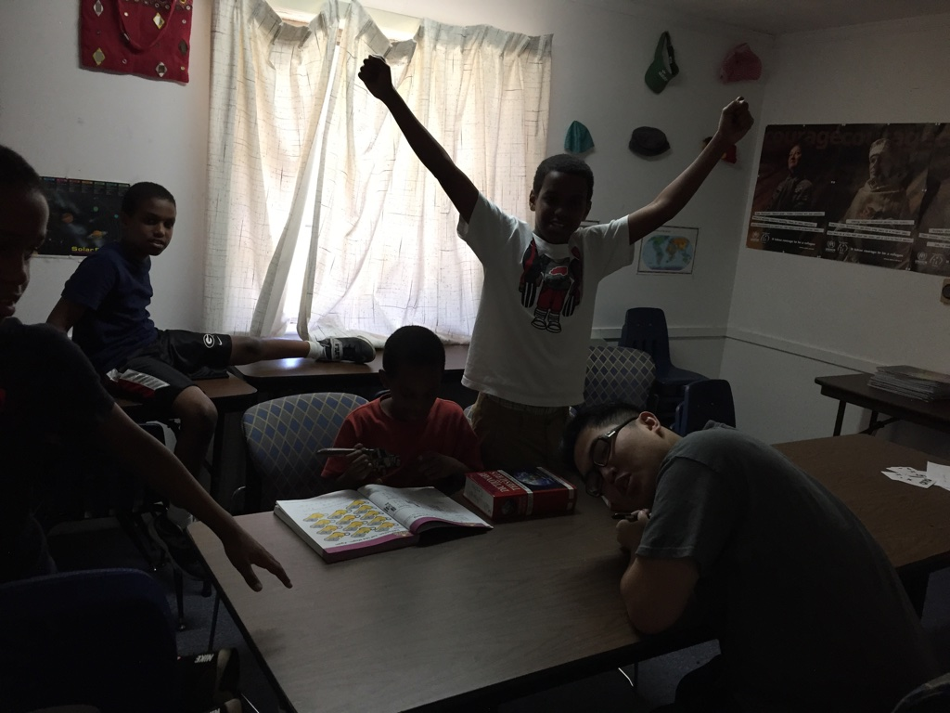
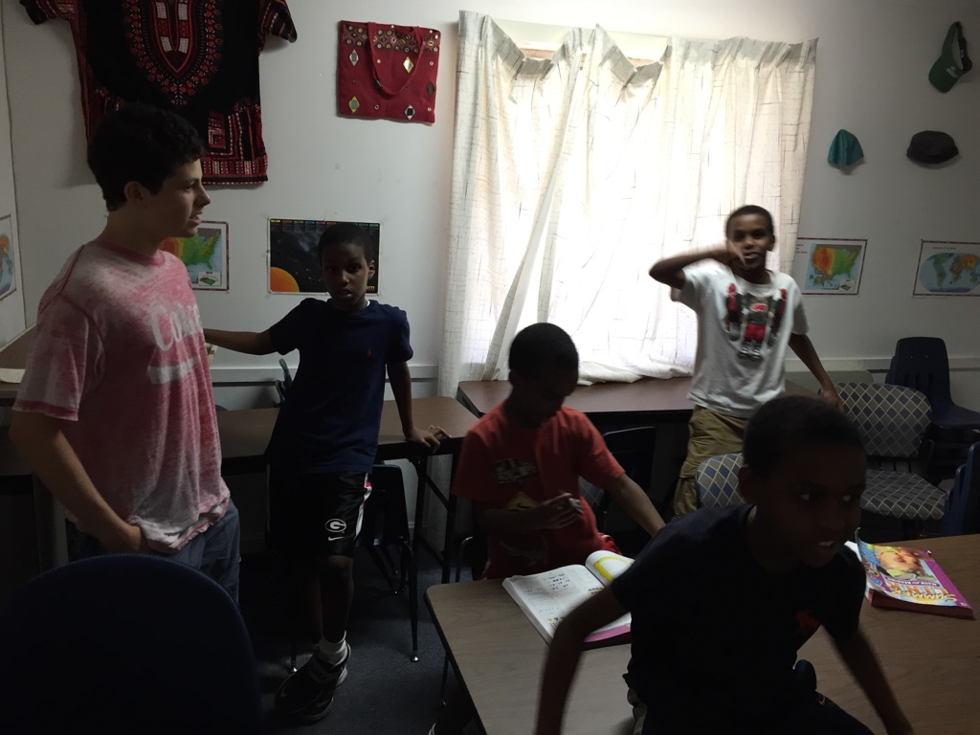
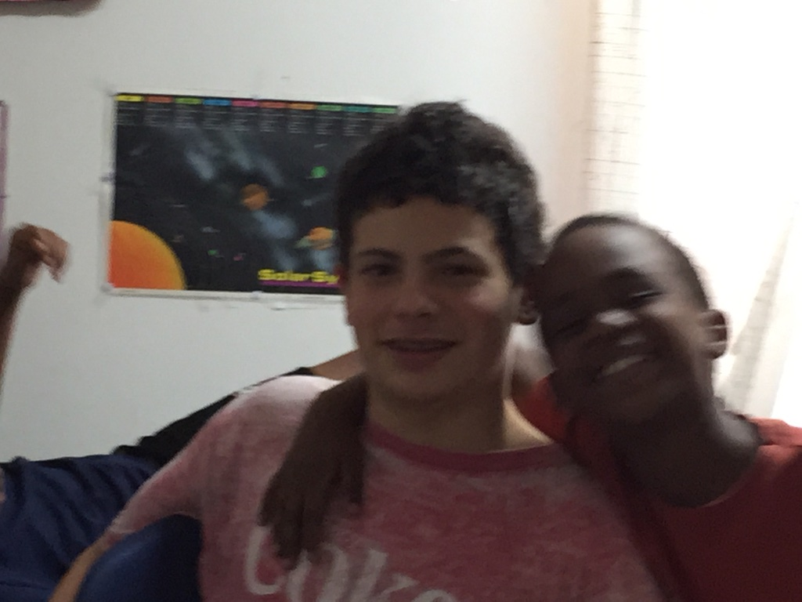
We tutor refugees
We tutor them and help them
with their website

Slide 17
Development

Slide 18
requirements
Extensive research
Requirements document
wire frames(UI prototype)
Create end user documentation first
Make priorities

Slide 19
Design
Focus on priorities
strive to find the simplest solution
Research
Break down the program into parts and decouple the parts so that I can easily, change, optimize, and augment each part

Slide 20
Prototyping
Essential for rapid innovation
Prototype most questionable parts
Find flaws
Find edge cases

Slide 21
Agile Development
We implement one story(feature) at a time from end to end and confirm that it works before moving on to the next feature.

Slide 22
Test driven development
Red Green Refactor
Red: I sometimes write an automated test for my code before writing the code. This helps to further specify what I need to do and makes my tests more thorough
Green: quickly write the code
Refactor: I refactor to improve the code.

Slide 23
Automated testing
automated tests are fast, repeatable, reliable, and leave accurate records
Compile time: the best time to find a bug is at compile time
Preconditions check the arguments of methods
Unit tests: test pieces of code and make sure they have the correct output for the input.
Regression tests. If I find a bug that could come back I make sure that it is tested automatically
System test: I automatically test my code like a user would
Load test: I use programs that simulate many users using my app

Slide 24
Automated builds with gradle
The build automatically
installs gradle
gets dependencies
Generates code for me
Compiles code
Optimizes code
Optimizes a different version of my code for each browser
Puts everything in the webapp directory
Starts the server
runs automatic tests
Stops the server
Packages the webapp into a war file

Slide 25
Automated deployment
No risk of human error
Don’t wait till the last minute to deploy
Deploying easily and quickly, is essential for agile development

